Slide 1
Team Signal Green: Initial Report
Waqar Aziz
James Kerr
Adeela Saalim
Andrea Senf
Yoann Strigini

Slide 2
Aims
Create a traffic simulation software where we can test various traffic management strategies that will teach us new skills and receive full marks.
Includes:
GitHub, environments and tools
Working as a team
Developing large-scale software

Slide 3
Strategy
Agent-Based Modeling (ABM)
RePast Simphony framework
Java, Eclipse editor
SCRUM methodology
Asana, InstaGantt, WhatsApp, in Person

Slide 4
Strategy
Week 16 February:
basic traffic simulation working
set finished project goals
Week 2 March:
final project goals complete
begin analysis of traffic models and strategies
low priority functionality may be implemented

Slide 5
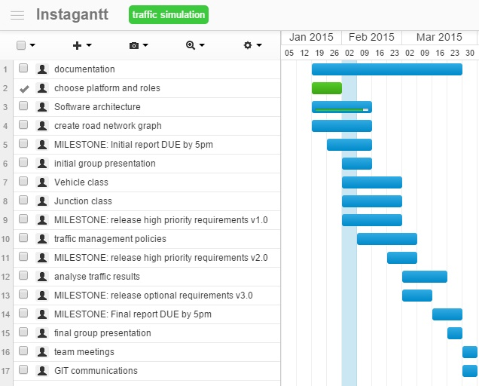
Timeline and Tasks

Slide 6
Roles and Teamwork
Architecture : James and Yoann
Environment : Waqar and Adeela
Coordinator and Documentation : Andrea

Slide 7
Assessment and Conflicts
Assessment : equal work and equal points
Concerns : raised when noticed so can be addressed

Slide 8
Current Work

Slide 9
Questions?

